Slide 1
Recent Developments in Data Science @ Berkeley
DS-100
&
Principles and Techniques of Data Science
Joseph E. Gonzalez Asst. Professor in EECS
jegonzal@berkeley.edu

Slide 2
Recent Developments in Data Science @ Berkeley
DS-100
Principles and Techniques of Data Science
ds100.org
Joseph E. Gonzalez Asst. Professor in EECS
jegonzal@berkeley.edu

Slide 3
Course Development
DS-100
Started active course development in Spring 2016
Reference: CS 194-16 Introduction to Data Science
Initially: focused more on tools
Eventually: fairly advanced many techniques and topics covered
Big Decisions
Intermediate level
Narrow scope
Minimize pre-req. chain
Strong stats. perspective
DS-100
8
Upper
Div.
Data
Principles and Techniques of Data Science
ds100.org

Slide 4
Our Goals
Prepare students for advanced Berkeley courses in data-management (CS186), machine learning (CS189), and statistics (Stat-154), by providing the necessary foundation and context
Enable students to start careers as data scientists by providing experience in working with real data, tools, and techniques
Empower students to apply computational and inferential thinking to tackle real-world problems

Slide 5
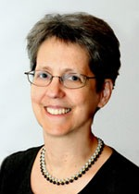
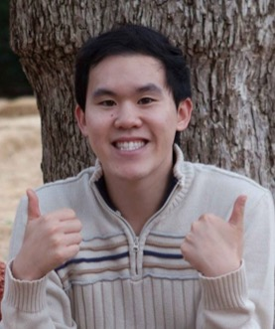
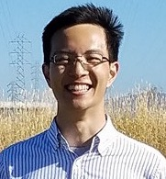

DS100 Created and Taught by Faculty and TAs With Diverse Background & Perspectives
Joseph Gonzalez
Joseph
Hellerstein
Deborah
Nolan
Bin
Yu
Andrew
Do
Henry
Milner
Sam
Lau
Joseph
Simonian

Slide 6
Data Science Requires Many Skills
Domain Expertise
Can’t cover everything in DS100.
Instead we cover
Key Concepts
… some details
Connections
How to learn …
Data
Science
Computer
Science
Statistics

Slide 7
Big Concepts in Data Science
Data preparation and representation
Efficient and scalable data processing
Question formulation and experimental design
Exploratory data analysis and visualization
Modeling fitting and inference
Machine learning techniques and overfitting
Validation and hypothesis testing

Slide 8
Data Science Lifecycle
Ask Question
Obtain
Data
High-level description of the data science workflow
Frame questions & design experiments
Obtain and clean data
Summarize and visualize data
Inference and prediction
continuous process …
Understand
World
Understand
Data
Reports &
Data-Products

Slide 9
Using Real Tools
Focus on Python programming language
We will use various different technologies
Jupyter notebooks, pandas, numpy, matplotlib, SQL Server, github, Wrangler, plotly, tableau, Spark?, …
We won’t teach students everything …
Students will learn to read documentation
Students will learn to teach themselves
BETA WARNING: things will break …
Students will learn how to debug
Students will learn how to get help (Piazza)
Notes:
Look into plotly and tableau

Slide 10
Syllabus
Week 1
Week 2
Week 3
Week 4
Week 5
Week 6
HW 1
HW 2
HW 3
HW 4
Big Concepts in Data Science
Working with Real Data and SQL
Week 7
Week 8
Week 9
Week 10
Week 11
Week 12
HW 4
HW 5
HW 6
Basic Statistical Modeling
Review & Midterm
Spring
Break
ML Techniques
Model Estimation
DS-100
Week 13
Week 14
Week 15
Week 16
HW 6
HW 6
ML Techniques
RRR
Big Data Analytics
http://www.ds100.org/sp17/syllabus

Slide 11
The Data Science Major …
Advanced Computing & Statistics
Machine Learning
Social Context
Electives
We are working on it!
Goals
Interdisciplinary
Personalized
Technically deep
Contextualized
Pragmatic
Probability
External Concentration
Principles and Techniques of Data Science
Mathematics
Computing
College
Requirements
Mathematics
Computing
Foundations of Data Science (Data 8)

Slide 12
Recent Developments in Data Science @ Berkeley
DS-100
&
Principles and Techniques of Data Science
Joseph E. Gonzalez Asst. Professor in EECS
jegonzal@berkeley.edu
ds100.org

Slide 13
Recent Developments in Data Science @ Berkeley
DS-100
&
Principles and Techniques of Data Science
Research …
Joseph E. Gonzalez Asst. Professor in EECS
jegonzal@berkeley.edu
rise.cs.berkeley.edu

Slide 14
Berkeley’s lab tradition
5-6 Projects addressing big problem
Bringing faculty from different areas (in CS)

Slide 15
Berkeley’s lab tradition
Working for 5-6 years on a new major problem
Bringing faculty from different areas

Slide 16
Big
Data
Training
Big Model

Slide 17
Learning
Big
Data
Training
Big Model

Slide 18
RISE Lab
From live data to real-time decisions
AMP Lab
From batch data to advanced analytics

Slide 19
Learning
?
Big
Data
Training
Big Model

Slide 20

Learning
Big
Data
Conference
Papers
Training
Big Model
Dashboards and
Reports

Slide 21
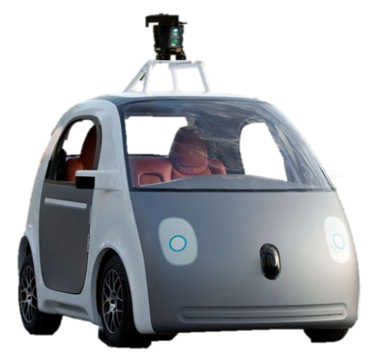
Learning
Conference
Papers
Big
Data
Training
Dashboards and
Reports
Big Model
Drive Actions

Slide 22
Learning
Conference
Papers
Dashboards and
Reports
Big
Data
Training
Big Model
Drive Actions

Slide 23
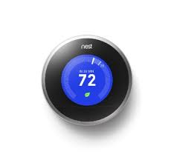



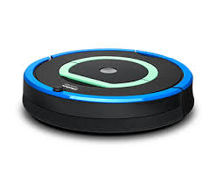



Drive Actions
Learning
Big
Data
Training
Big Model

Slide 24
why is challenging?
Inference
Need to render low latency (< 10ms) predictions for complex
Models
Queries
Features
SELECT * FROM
users JOIN items, click_logs, pages WHERE …
Top K
under heavy load with system failures.

Slide 25
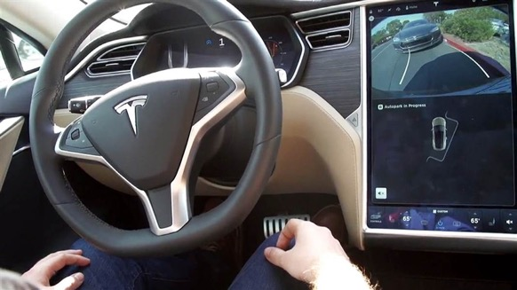
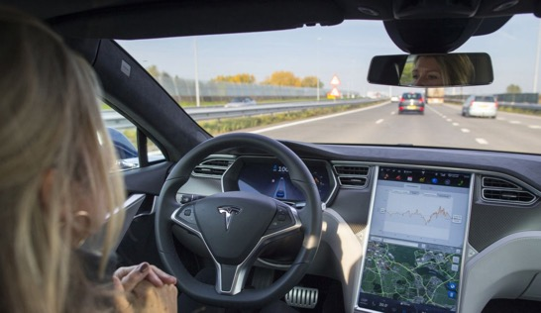
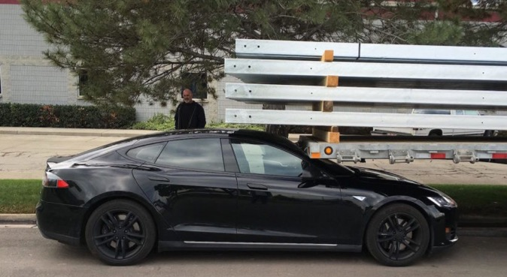
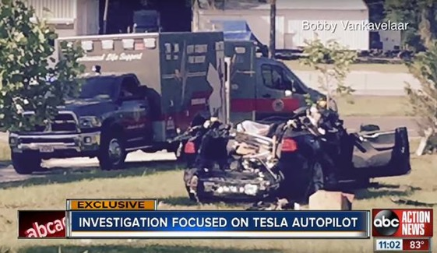
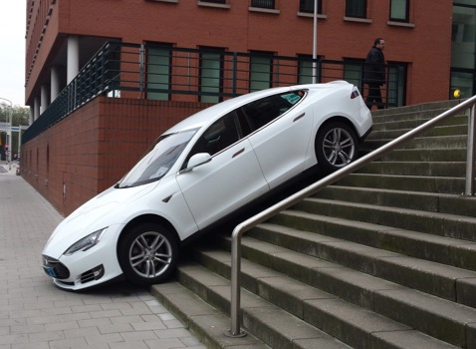
Robust is critical
Inference
Self “Parking” Cars
Self “Driving” Cars
Chat AIs

Slide 26
Learning
Inference
Big
Data
Query
Training
Decision
Big Model
Application
Feedback

Slide 27
Learning
Inference
Training
Decision
Big
Data
Timescale: hours to weeks
Often re-run training
Another area of focus in RISE
Application
Feedback

Slide 28
Why is challenging?
Closing the Loop
Implicit and Delayed Feedback
Self Reinforcing
Feedback Loops
World Changes
at varying rates

Slide 29
Learning
Inference
Big
Data
Query
Training
Responsive
(~10ms)
Adaptive
(~1 seconds)
Decision
Big Model
Application
Feedback

Slide 30
Learning
Inference
Adaptive
(~1 seconds)
Responsive
(~10ms)
Secure
Notes:
Adaptive is hard because of the complex training process that typically revisits the entire data set.
Responsive is hard because of complex often personalized models a elaborate queries

Slide 31

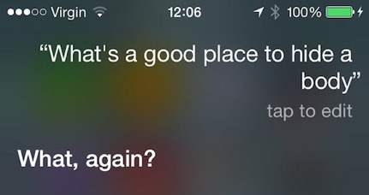
Intelligence in Sensitive Contexts
AR/VR Systems
Home Monitoring
Voice Technologies
Medical Imaging
Protect the data, the model, and the query

Slide 32

Protect the data, the model, and the query
High-Value Data is Sensitive
Medical Info.
Home video
Finance
Models capture value in data
Core Asset
Sensitive
Data
Queries can be as sensitive as the data

Slide 33

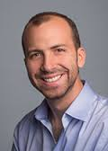
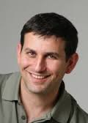
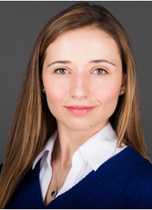

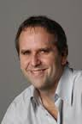
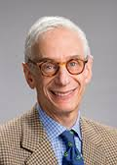
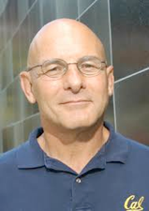
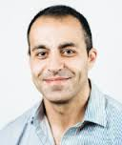
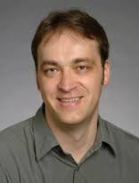
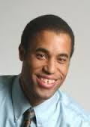
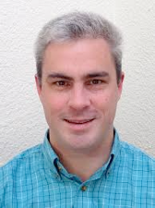
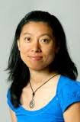
We are developing new technologies that will enables applications to make low-latency intelligent decision on live data with strong security guarantees.
Notes:
A new lab we are starting at UC Berkeley, as a continuation to Amplab
Amplab is a systems group at Berkeley that created Spark, Mesos and Tachyon, big data systems with a lot of impact. How many know of spark? It is used by hundreds of companies
These labs last 5-6 years and a new lab is created at the end so that we can always be on the next wave
So I will tell you about the new lab, which we believe to be the next big impactful vision
These labs bring together faculty from different disciplines that can help tackle that problem. We collaborate to solve this.
Main people are… a bunch of s ...
An important component of ours is partnering with companies.
Amplab has learned a lot from companies from the feedback they gave, companies got to use products, have students intern, and overall just have a good synergetic collaboration
Speaking of which, please give us any feedback you think of because we are still shaping the next lab
Authors

Slide 34
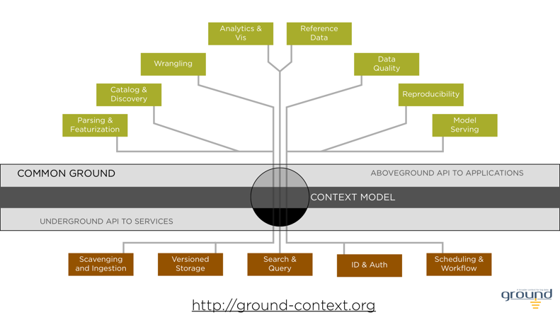
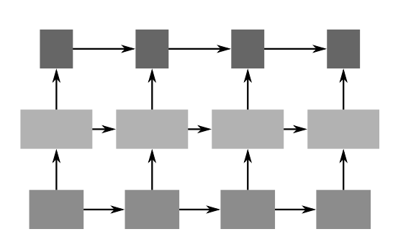
A few early projects …
Ray

Slide 35
How can I get involved in Research for RISE (or anywhere on campus)
Learn about the ongoing projects:
https://rise.cs.berkeley.edu
https://github.com/ucbrise
Email faculty and grad students to see if they have openings or are looking for help
Have an idea for the project!
Try to attend seminars hosted by the lab
We will start posting these soon!
Joseph E. Gonzalez (jegonzal@berkeley.edu)

